Slide 1

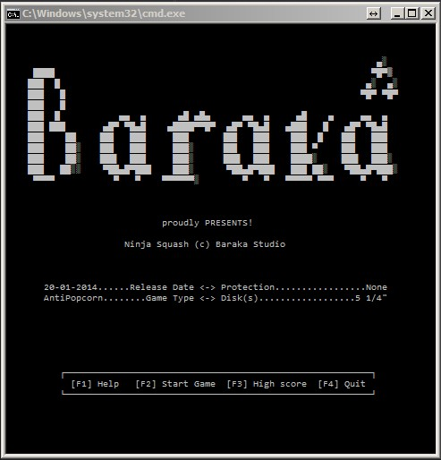
Team BARAKA
http://csharpfundamentals.telerik.com
Team Project for C# Part II – Console Game
Game Name: BARAKA
Project TFS
https://ttitto.visualstudio.com
Telerik Software Academy
academy.telerik.com

Slide 2
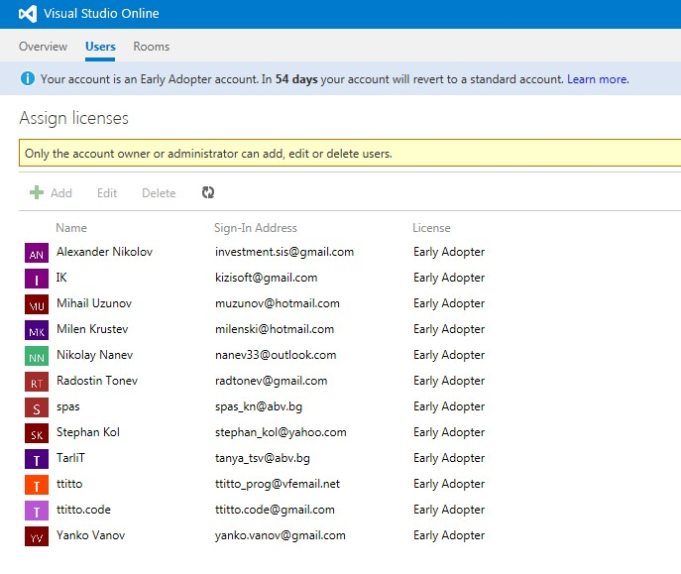
Team Facts
Eleven team members;
Three different sub-teams:
Game Interface;
Game Engine;
Documentation;
Used Repository – Visual Studio Online
TFS – https://ttitto.visualstudio.com
Setting up TFS was the first of many challenges we had to face during the project ☺

Slide 3
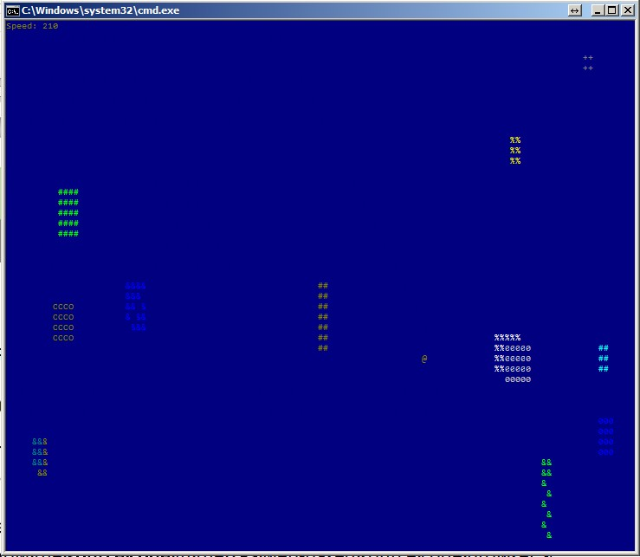
The Game BARAKA
Second one was choosing the game for the project ☺
We choose a game that we can finish with on time with all main planned functionality;
TFS was our “main instrument” and the team has gained considerable experience in dealing with it;

Slide 4
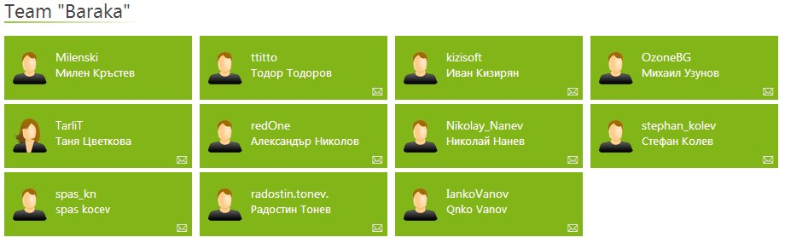
Team members name list
Thank You for your attention ☺

